Slide 1
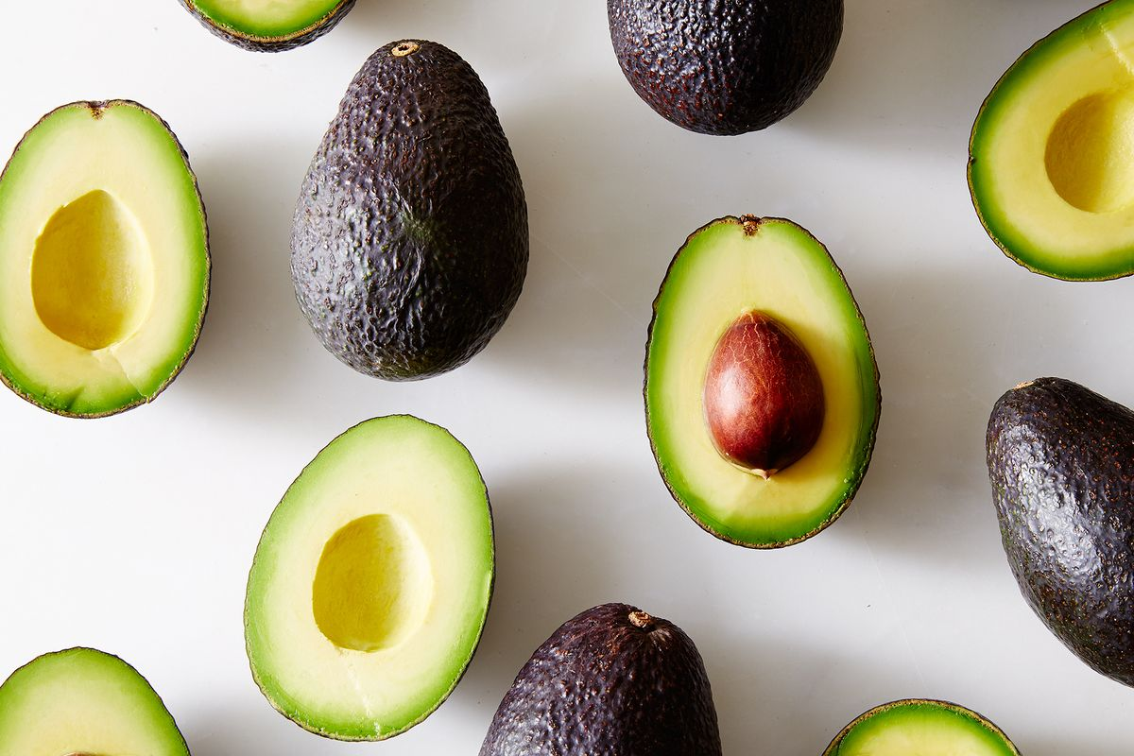
Measuring Avocado Prices Across Time, Type, & Region
By: Aaron Lumpkin, Pravitha Pratheep, Amanda Young

Slide 2
Business Understanding
Predicting and analyzing avocado sales across time and across different geographical regions within the U.S.
MOTIVATION:
Our goal is to help producers and farmers understand the profit potential of avocados depending on the growth method (conventional or organic) and to understand the market growth/potential for each type.
Through use of Rapidminer and Tableau visualizations we hope to reveal how…
Average prices of avocados have varied based on growing region/time of year/type
Volume of avocados sold varies in accordance with rise/fall of average prices of avocados
Who are the main stakeholders?
Avocado farmers and retailers at a local and commercial level will be directly impacted by these results
Can utilize these results to maximize profit potential and adopt a competitive business strategy (investing in either conventional or organic avocados)

Slide 3
Data Preparation and Understanding
Data taken from Hass Avocado Board
“Weekly 2018 retail scan for National retail volume (units) and prie”
No data preparations were done as the avocadoes data set was clean.
The dataset contains 18,250 rows and 10 columns.
The features (variables) included in the dataset include average price, type (conventional/organic), year, region, total volume (total number of avocados sold), 4046 (Total number of avocados with PLU 4046 sold), 4225 (total number of avocados with PLU 4225) and 4770 (number of avocados sold with PLU 4770).
Target Variable - Average Price of Avocados
Predictor Variables - Type of Avocado (Conventional/Organic), Year, Volume, Region
EDA visualizations made on Tableau
(see next slides)
Notes:
PLU = Price Lookup Code

Slide 4
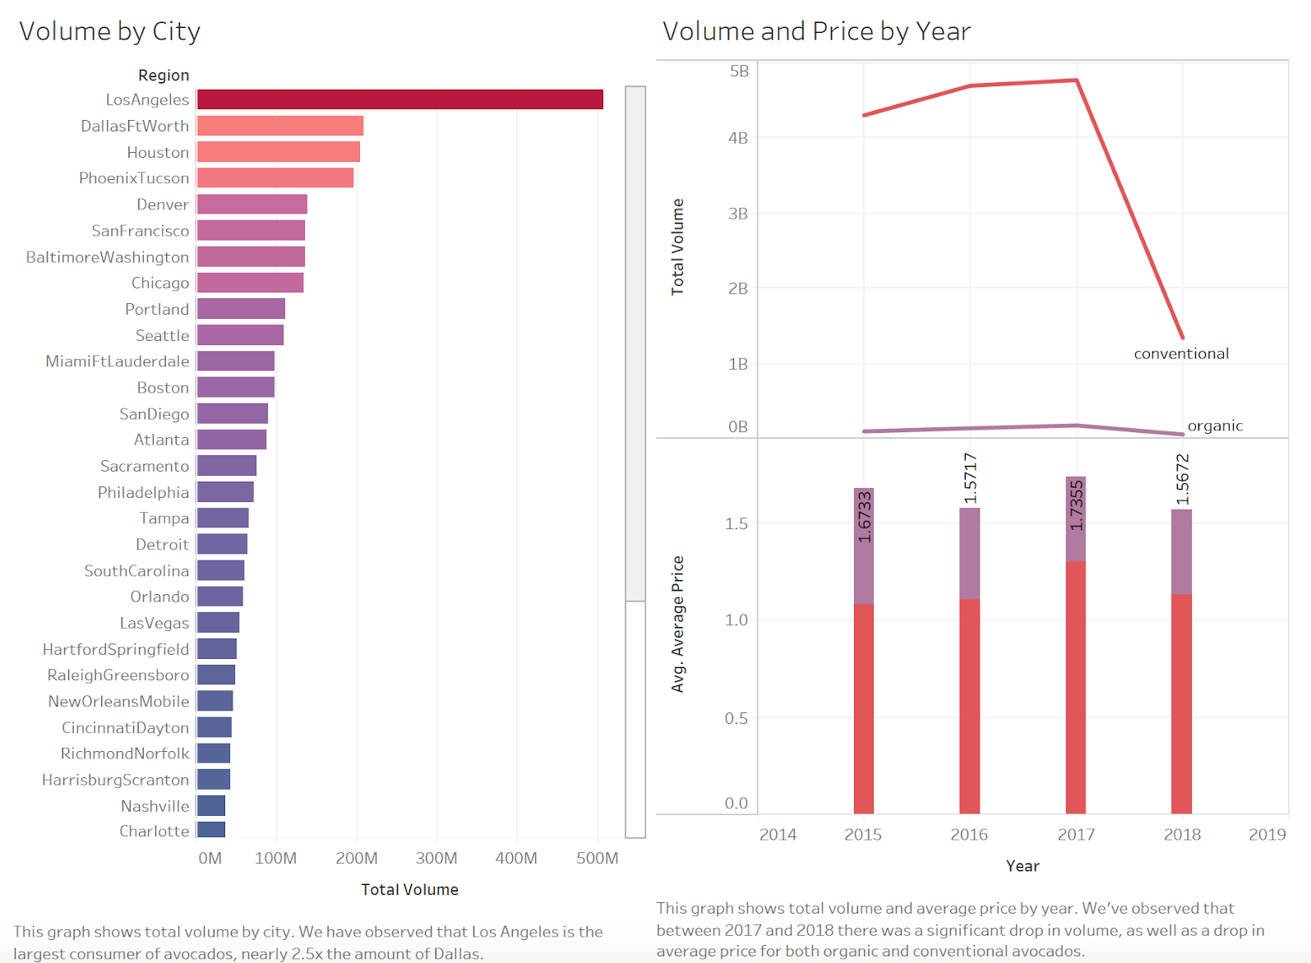

Slide 5
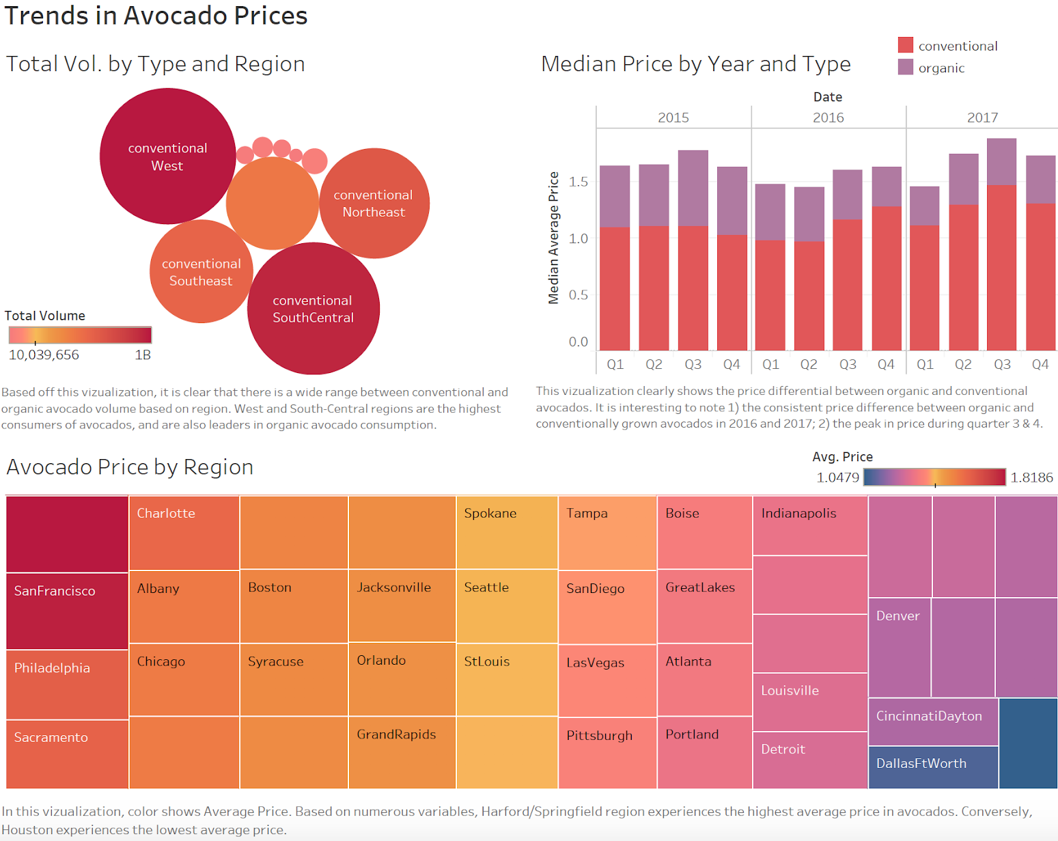

Slide 6
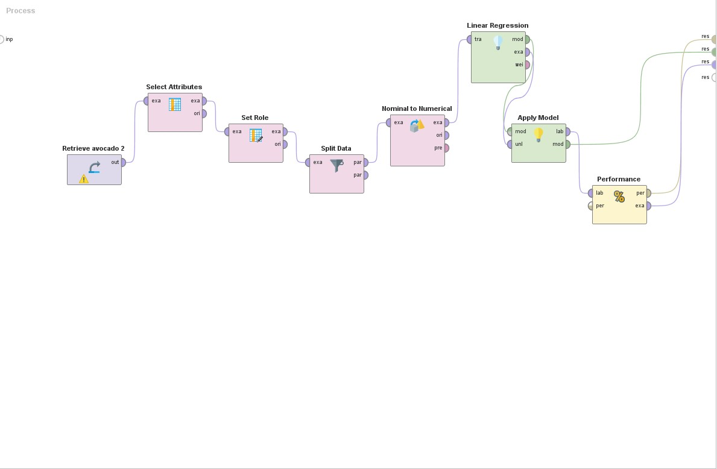
Modeling
Multiple Linear Regression Model

Slide 7
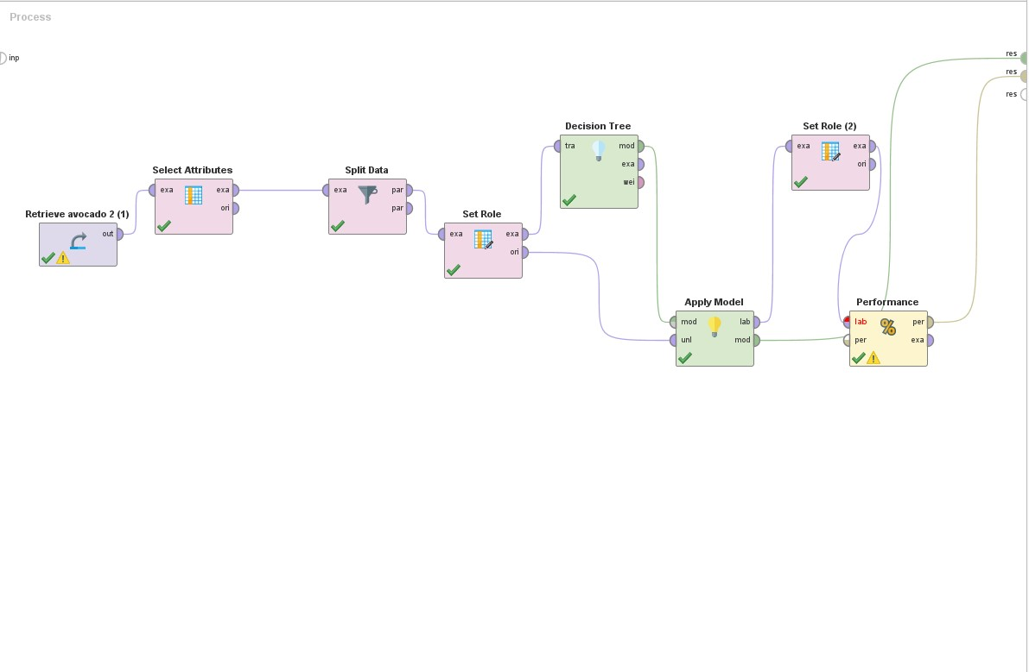
Modeling
Linear Regression Model
Decision Tree Modeling

Slide 8
Results and Evaluation
Multiple Linear Regression Model:
Best predictors are type and year
P-values were both 0
Coefficient of year = 0.041
Coefficient of conventional avocado = -0.249
Coefficient of organic avocado = 0.249
Decision Tree Model:
Accuracy of 80.76% with high percentage in recall and precision
Most organic avocados were priced higher
Very rare situations organic and conventional avocados were equally priced

Slide 9
Results and Evaluation
Comparison:
Multiple linear regression would be more suitable to predict average price of avocados.
Decision tree model is suitable as a support to the variable type and year.
The decision tree showed the ratio of conventional to organic amount and the prices they are priced at in each year.
Decision tree helps to predict the type of avocado to plant.

Slide 10
Recommendations
Avocado farmers and growers must consider their region in the world, and the volume potential of their land/area to help decide which sector of the avocado market to capitalize on.
Organic Avocados:
Small farming capacity and low output volume (compared to conventional)
Greater profit potential (Higher sale price, balanced with slightly higher operational cost)
Conventional Avocados
A steady, majority portion of the avocado market
Large farming capacity and high output volume
Steady, reliable profit potential (Lower sales price with slightly lower operational cost)
Farmers and growers can capitalize of analysis of regional consumption of avocados, indicating that coastal cities make up the largest consumer markets for avocados.

